Slide 1

Task 1: Data Overview Internship at Cognifyz Technologies
Karishma Kolhe
Business Analytics Intern

Slide 2
Objective: Understand the dataset structure
The objective of this task was to load a given dataset into a data analysis tool (such as Python with pandas) and perform an initial analysis to understand its structure. This involved importing the dataset, checking for basic information like the number of entries, columns, and data types, and using descriptive statistics to ensure the dataset is well-organized. By performing this analysis, I gained insights into the dataset’s composition, which is crucial for further data processing and analysis.

Slide 3
Load the dataset
Imported the pandas library to handle and analyze the dataset.
Used pd.read_csv() to load the dataset.
Stored the loaded dataset in a pandas DataFrame named df.
Previewed the first 5 rows of the dataset using df.head() to check its structure and ensure the data loaded correctly

Slide 4
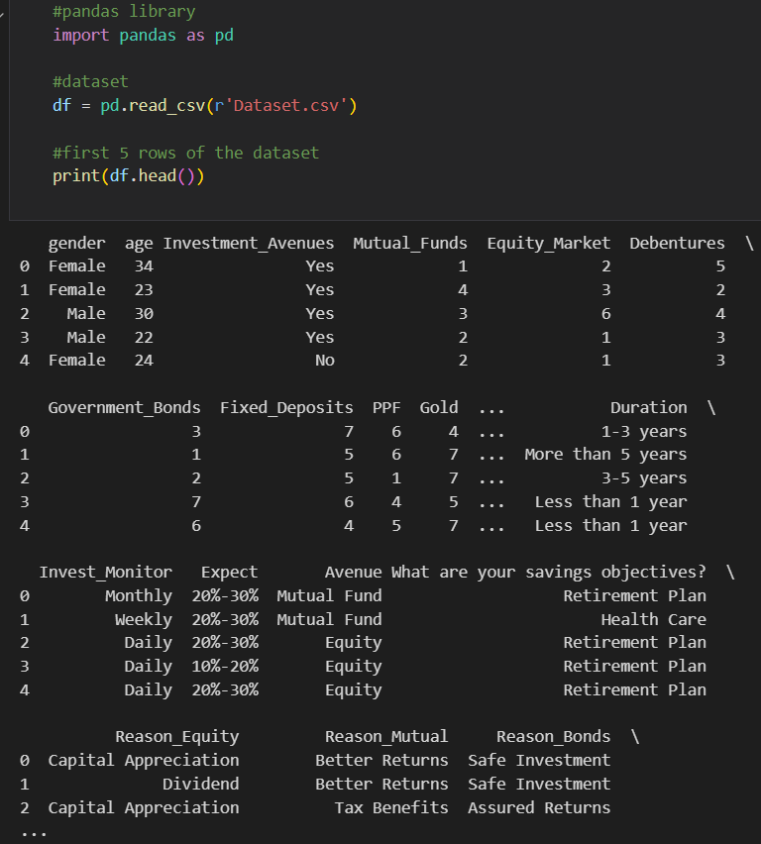

Slide 5
Descriptive Statistics
Imported the pandas library to analyze the dataset' s structure and statistics.
Used df.info() to gather details about the dataset, such as the number of entries, columns, and data types.
Analyzed the dataset' s structure, ensuring all 40 entries had valid data across 24 columns with no missing values.
Used df.describe() to calculate basic statistical measures (e.g., mean, standard deviation, min, max) for the numeric columns.
The descriptive statistics helped in understanding the distribution and range of values for numerical attributes in the dataset.

Slide 6
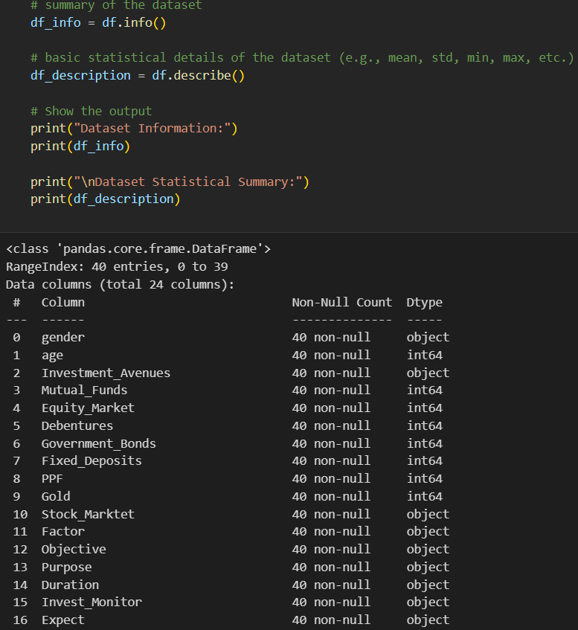

Slide 7
Conclusion and Next Steps
Conclusion:
Task 1: Data Overview completed successfully (Dataset loaded and analyzed using descriptive statistics).
Task 2: Gender distribution analysis will be the next step, which will include visualization of the dataset’s gender distribution.
Next Steps:
Task 2: Create and visualize gender distribution (bar chart/pie chart)

Slide 8
Thank You Feel free to reach out for any questions or feedback. GitHub Linkedin

